Slide 1





Apple’s Annual Report
Aditi Vijay Sonawane

Slide 2

Table of contents
01
02
03
04
About Apple
Review of Income Statement
Review od Balance sheet
Review of Cashflow Statement

Slide 3

01
About Apple

Slide 4

Introduction
Headquartered in Cupertino, California, Apple Inc. is a global leader in technology and digital services.
Founded in 1976 by Steve Jobs, Steve Wozniak, and Ronald Wayne.
Known for products like iPhone, iPad, Mac, Apple Watch, AirPods, and Apple TV.
Offers integrated services including App Store, iCloud, Apple Music, and Apple TV+.
As of October 2025, holds a $3.47 trillion market cap and $408 billion annual revenue

Slide 5
-CEO Tim Cook
“We believe that business, at its best, serves the public good, empowers people around the world, and binds us together as never before’’

Slide 6
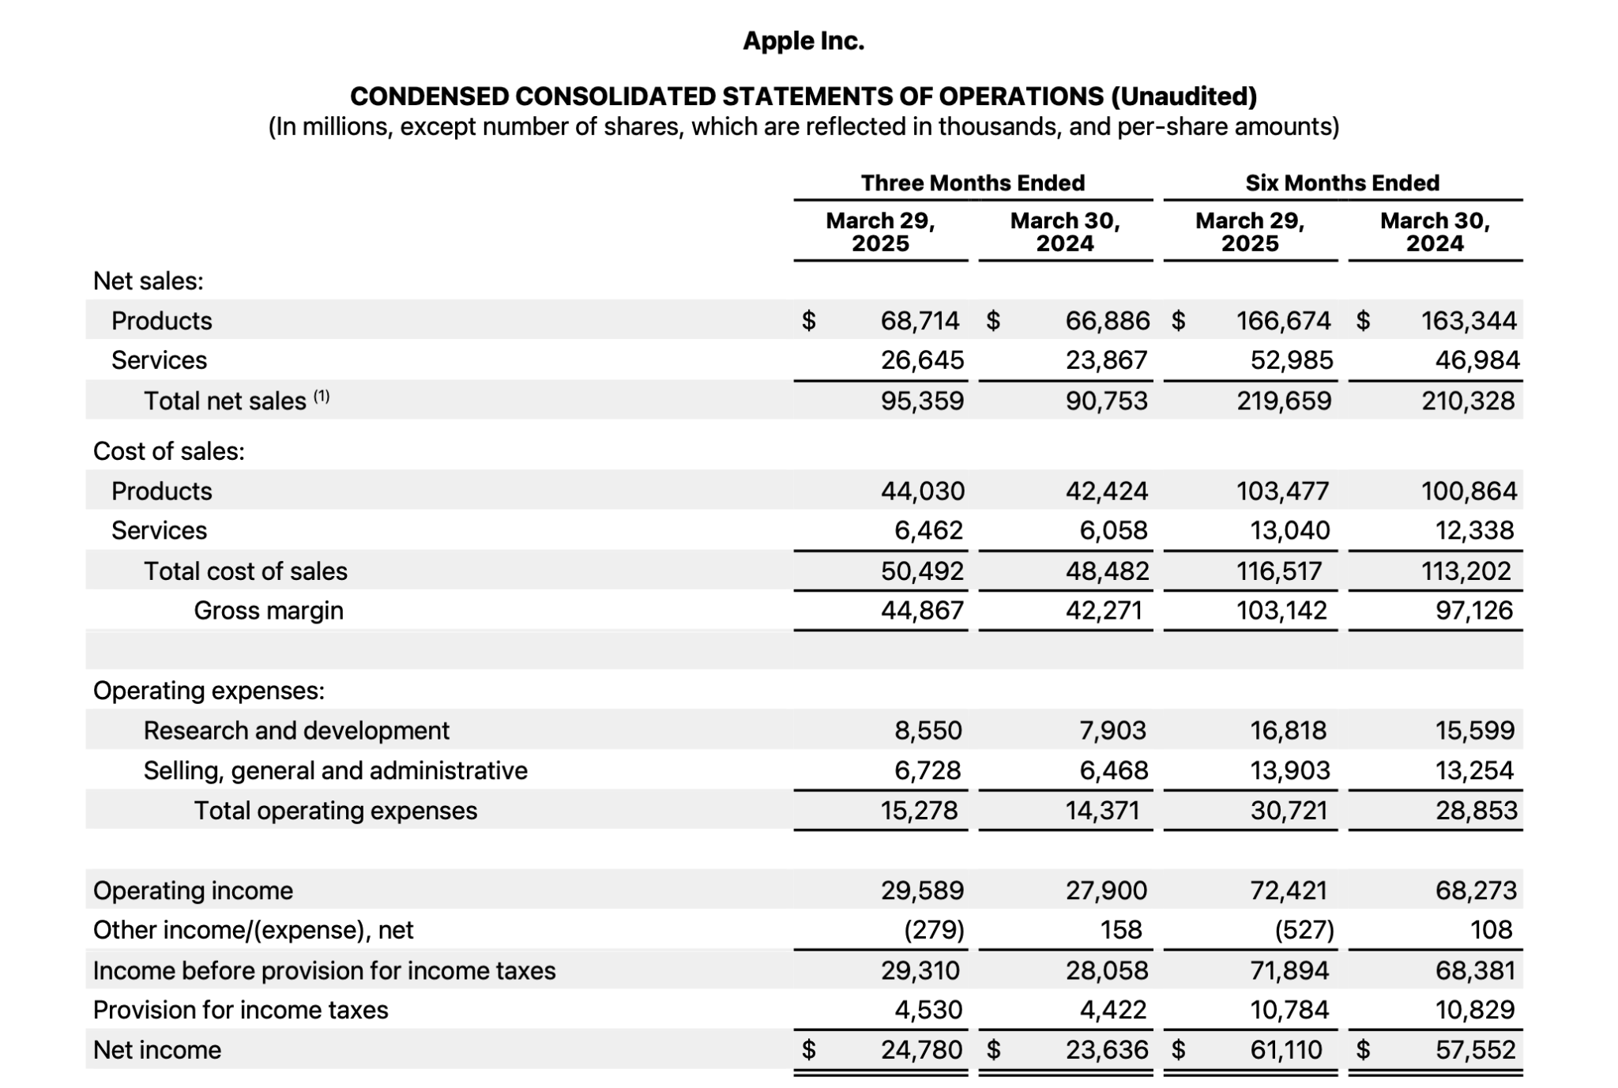
Review of Income Statement
Net sales: $95.4 billion ($68.7B products, $26.6B services).
Gross margin: $44.9 billion.
Operating expenses: $15.3 billion (R&D and SG&A).
Operating income: $29.6 billion.
Net income: $24.8 billion.

Slide 7
Review of Balance Sheet
Inventories for Apple Inc. were $6.27 billion, down from $7.29 billion in September 2024, reflecting product mix changes and lower input costs.​
Cash and cash equivalents were $28.16 billion as of March 29, 2025, lower than $29.94 billion at the prior year-end, while total current assets declined to $118.67 billion from $152.99 billion.​
Non-current assets, which include property, plant & equipment and long-term investments, were $212.56 billion, slightly up from $211.99 billion in September 2024.​
Total assets stood at $331.23 billion on March 29, 2025, compared to $364.98 billion as of September 28, 2024.​
Total current liabilities for Apple were $144.57 billion, down from $176.39 billion at the prior year-end, indicating a reduction in short-term financial obligations.​
Total liabilities were $264.44 billion, down from $308.03 billion in September 2024.​
Total shareholders' equity was $66.80 billion, up from $56.95 billion at the prior year-end.​

Slide 8
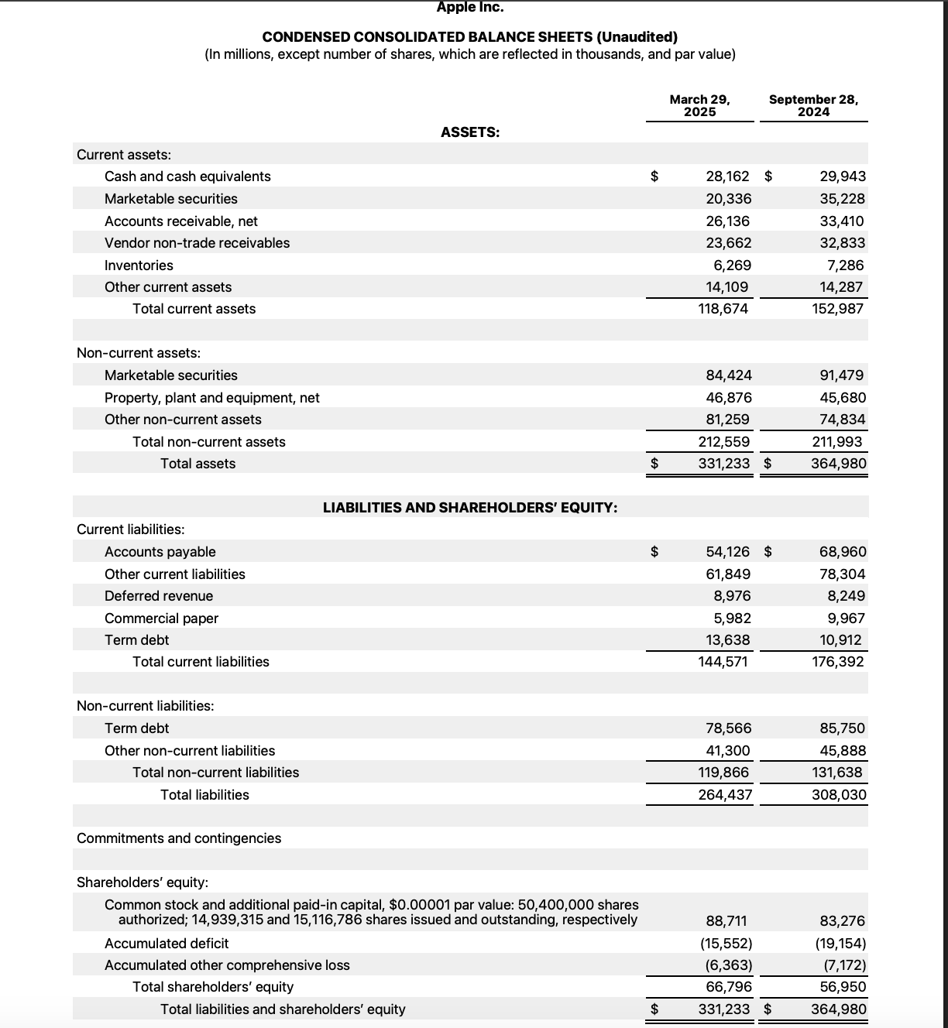

Slide 9

Review of Cash Flow Statement
Cash and cash equivalents totaled $28.2 billion, slightly down from $29.9 billion at the prior year-end, as funds were allocated to share repurchases, dividends, and capital expenditures.
Total current assets were $118.7 billion, a decrease from $153.0 billion in September 2024.
Apple’s non-current assets (including property, plant, equipment, and long-term investments) stood at $212.6 billion, up slightly from $212.0 billion.
Total assets amounted to $331.2 billion by the end of March 2025, down from $365.0 billion at the 2024 fiscal year-end.
Total current liabilities were $144.6 billion, lower than the previous $176.4 billion, mostly due to lower accounts payable and other current liabilities.
Apple’s total liabilities fell to $264.4 billion from $308.0 billion in September 2024.
Total shareholders’ equity increased to $66.8 billion from $57.0 billion, indicating a stronger equity position through the period.

Slide 10
